Slide 1

CIS 465
Neural Network and Pattern Recognition
Dr. Sifat Momen

Slide 2
What is Machine Learning?
“Learning is any process by which a system improves performance from experience.”
- Herbert Simon
Definition by Tom Mitchell (1998):
Machine Learning is the study of algorithms that
improve their performance P
at some task T
with experience E.
A well-defined learning task is given by <P, T, E>.

Slide 3
Traditional Programming
Data Program
Computer
Output
Machine Learning
Data Output
Computer
Program
Slide credit: Pedro Domingos

Slide 4
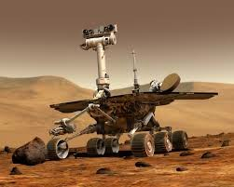
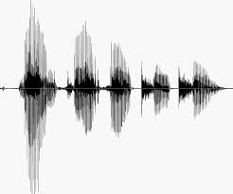
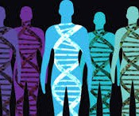
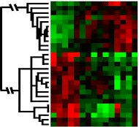
When Do We Use Machine Learning?
ML is used when:
Human expertise does not exist (navigating on Mars)
Humans can’t explain their expertise (speech recognition)
Models must be customized (personalized medicine)
Models are based on huge amounts of data (genomics)
Learning isn’t always useful:
There is no need to “learn” to calculate payroll
Based on slide by E. Alpaydin

Slide 5
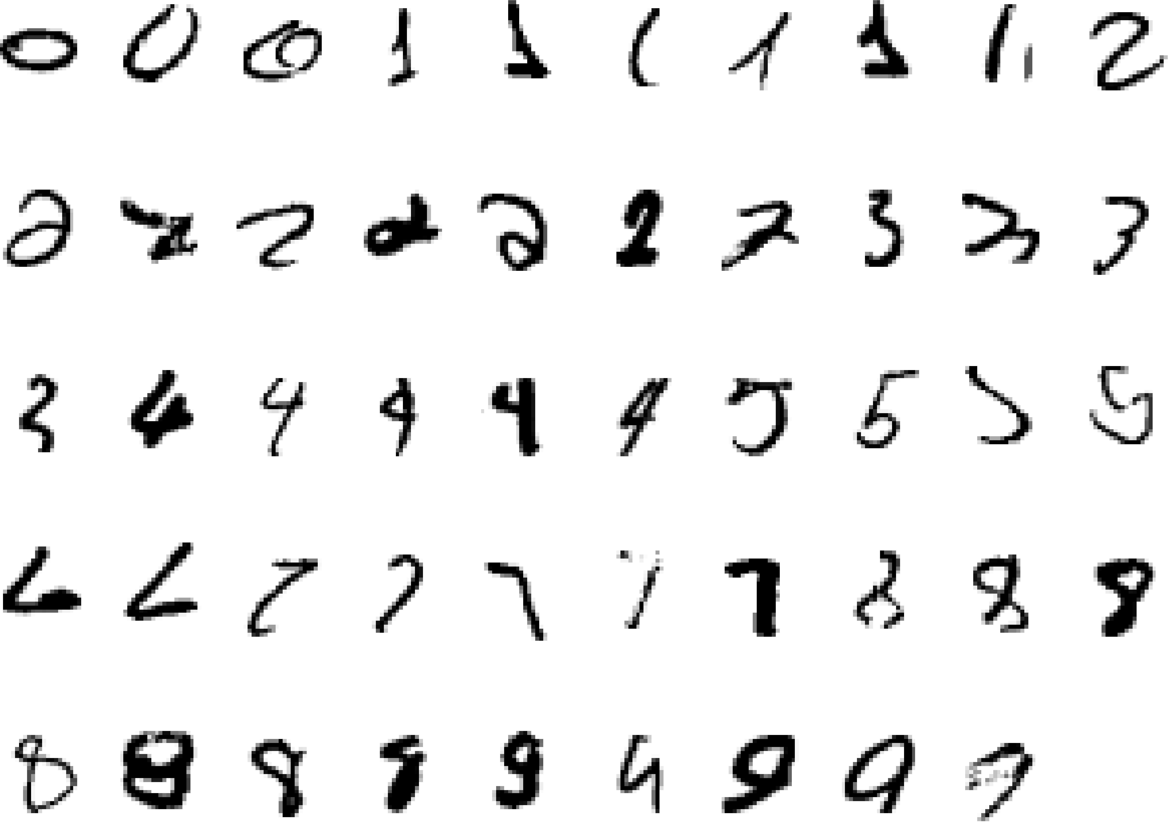
A classic example of a task that requires machine learning: It is very hard to say what makes a 2
Slide credit: Geoffrey Hinton

Slide 6
Some more examples of tasks that are best solved by using a learning algorithm
Recognizing patterns:
Facial identities or facial expressions
Handwritten or spoken words
Medical images
Generating patterns:
Generating images or motion sequences
Recognizing anomalies:
Unusual credit card transactions
Unusual patterns of sensor readings in a nuclear power plant
Prediction:
Future stock prices or currency exchange rates
Slide credit: Geoffrey Hinton

Slide 7
Sample Applications
Web search
Computational biology
Finance
E-commerce
Space exploration
Robotics
Information extraction
Social networks
Debugging software
[Your favorite area]
Slide credit: Pedro Domingos

Slide 8
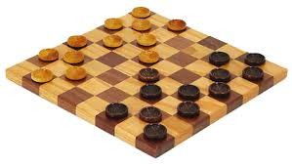
Samuel’s Checkers-Player
“Machine Learning: Field of study that gives computers the ability to learn without being explicitly programmed.” -Arthur Samuel (1959)

Slide 9
Defining the Learning Task
Improve on task T, with respect to performance metric P, based on experience E
T: Playing checkers
P: Percentage of games won against an arbitrary opponent E: Playing practice games against itself
T: Recognizing hand-written words
P: Percentage of words correctly classified
E: Database of human-labeled images of handwritten words
T: Driving on four-lane highways using vision sensors
P: Average distance traveled before a human-judged error
E: A sequence of images and steering commands recorded while observing a human driver.
T: Categorize email messages as spam or legitimate. P: Percentage of email messages correctly classified. E: Database of emails, some with human-given labels
Slide credit: Ray Mooney

Slide 10
State of the Art Applications of Machine Learning

Slide 11
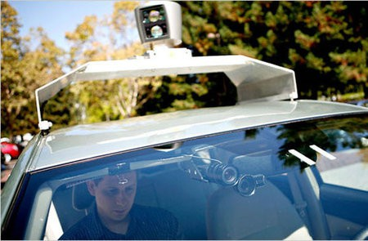
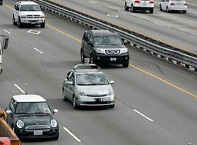
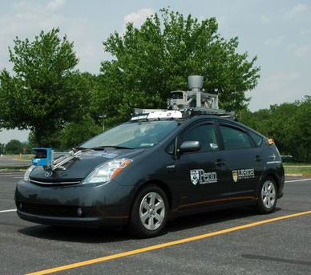
Autonomous Cars
Nevada made it legal for autonomous cars to drive on roads in June 2011
As of 2013, four states (Nevada, Florida, California, and Michigan) have legalized autonomous cars
Penn’s Autonomous Car →
(Ben Franklin Racing Team)

Slide 12
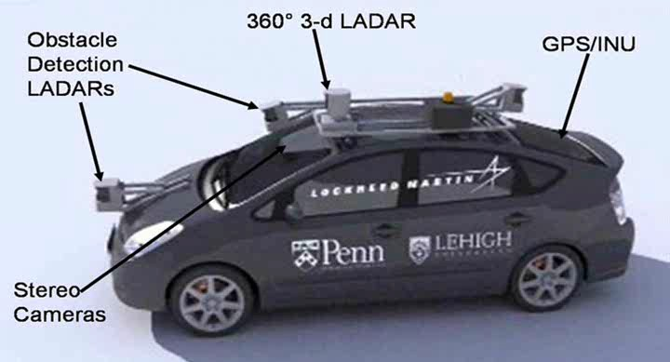
Autonomous Car Sensors

Slide 13
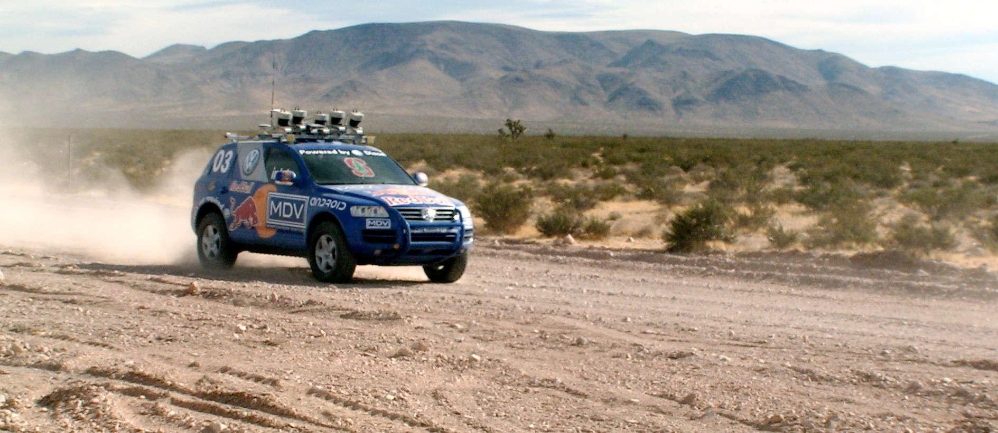
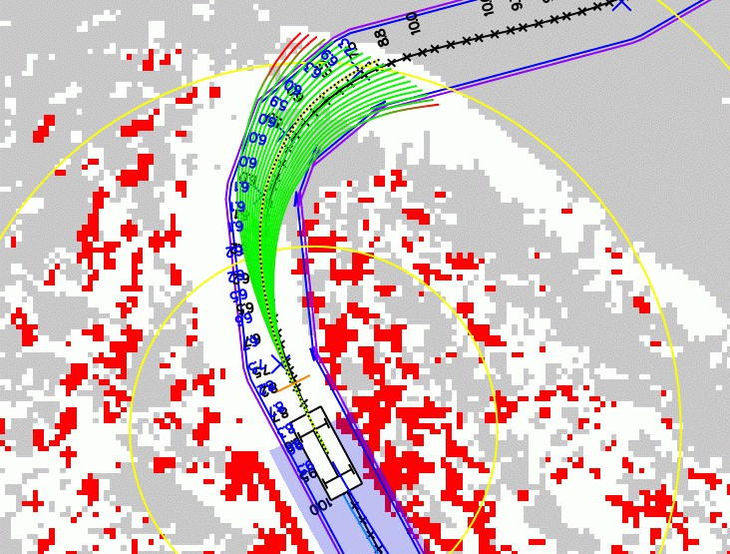
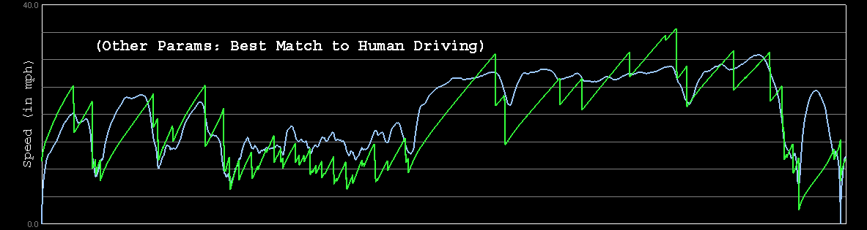
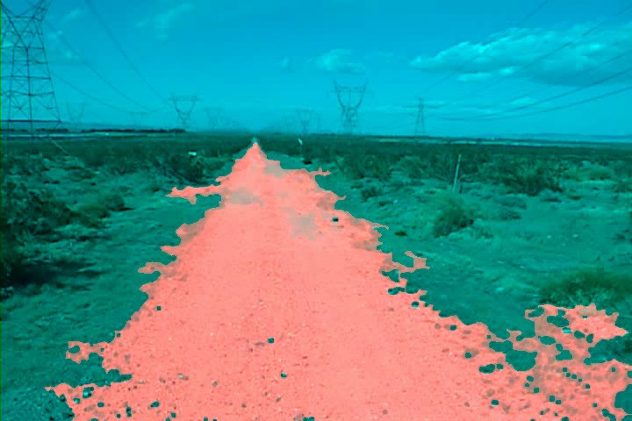
Autonomous Car Technology
Path Planning
Laser Terrain Mapping
Learning from Human Drivers
Sebastian
Adaptive Vision
Stanley

Slide 14


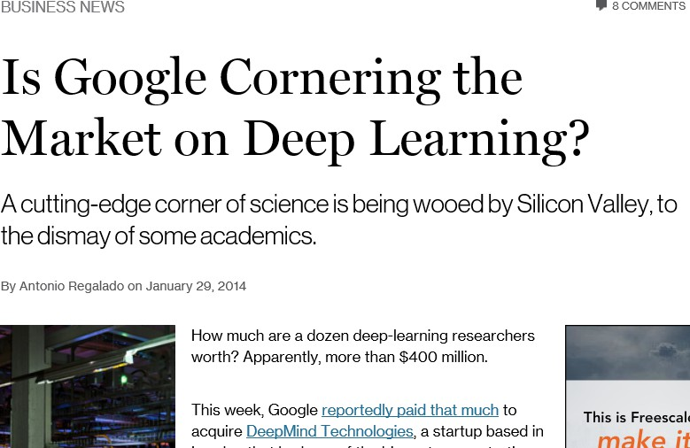
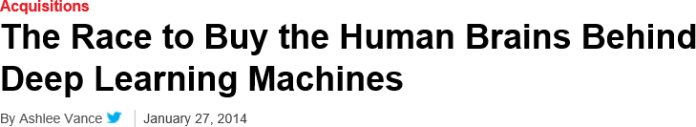
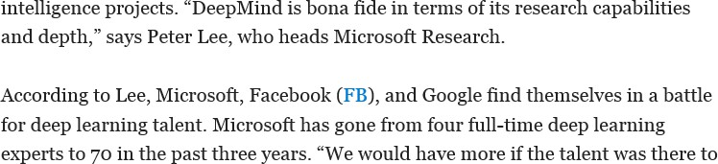
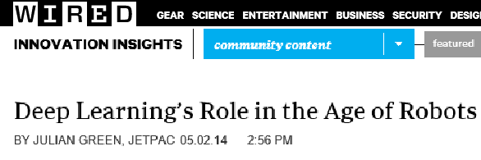
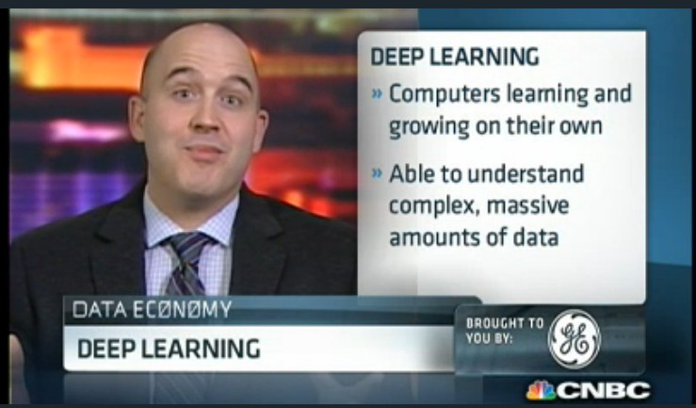
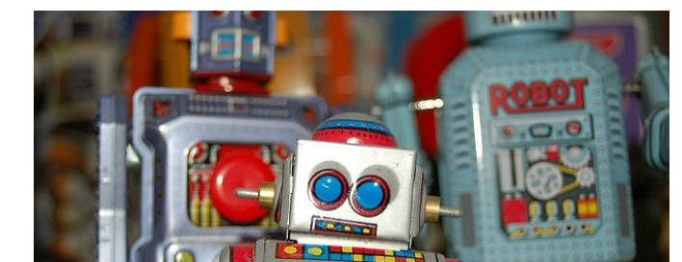
Deep Learning in the Headlines
15

Slide 15
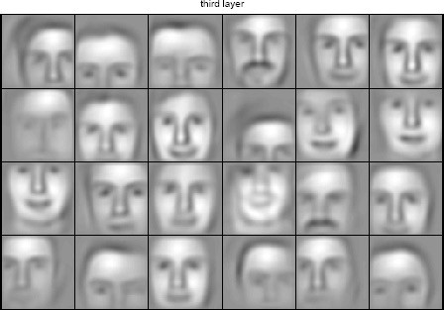
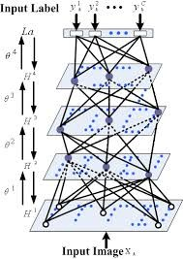

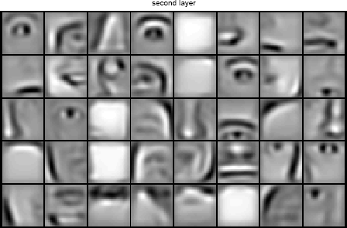


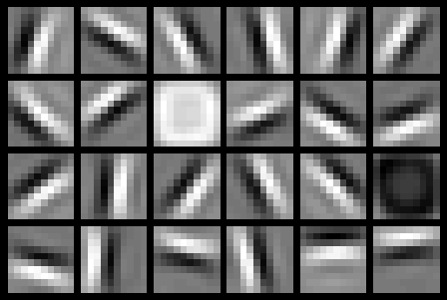
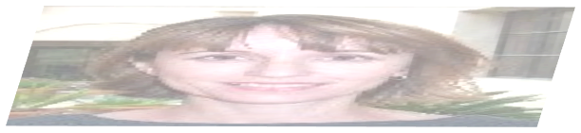


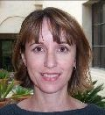
Deep Belief Net on Face Images
object models
object parts (combination of edges)
edges
pixels
Based on materials by Andrew Ng

Slide 16
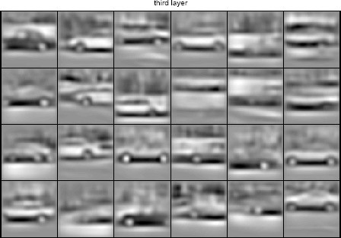
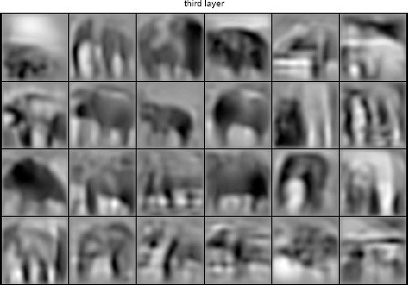
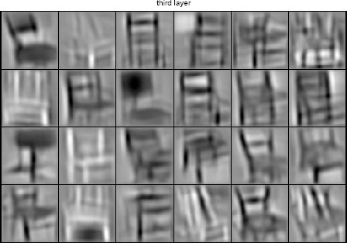
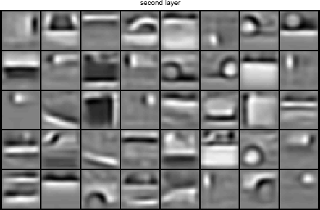
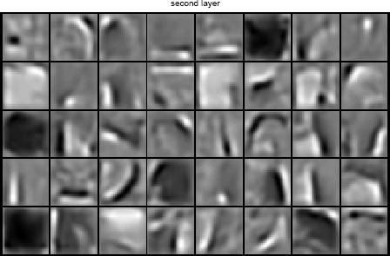
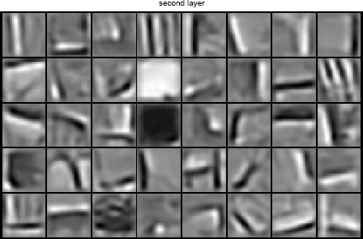
Learning of Object Parts
Slide credit: Andrew Ng

Slide 17
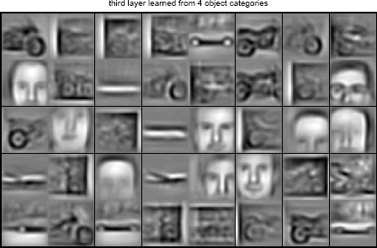
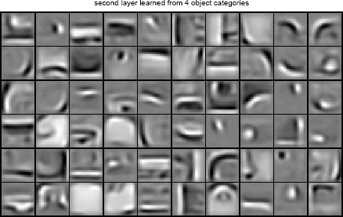
Training on Multiple Objects
Trained on 4 classes (cars, faces, motorbikes, airplanes).
Second layer: Shared-features and object-specific features.
Third layer: More specific features.
Slide credit: Andrew Ng

Slide 18
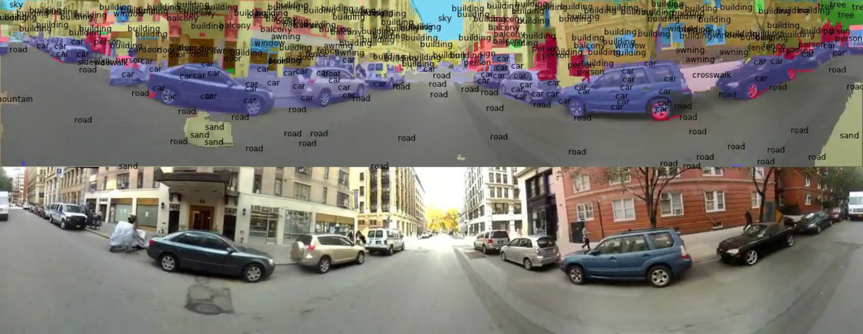
Scene Labeling via Deep Learning
[Farabet et al. ICML 2012, PAMI 2013]

Slide 19
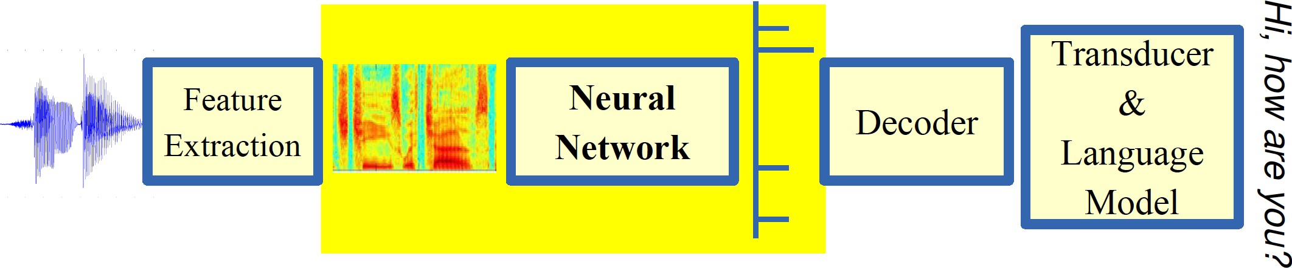
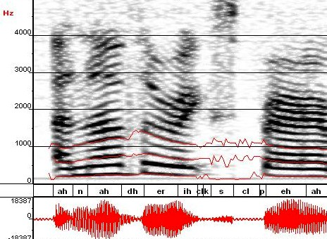
Machine Learning in Automatic Speech Recognition
A Typical Speech Recognition System
ML used to predict of phone states from the sound spectrogram
Deep learning has state-of-the-art results
# Hidden Layers | 1 | 2 | 4 | 8 | 10 | 12
Word Error Rate % | 16.0 | 12.8 | 11.4 | 10.9 | 11.0 | 11.1
Baseline GMM performance = 15.4%
[Zeiler et al. “On rectified linear units for speech recognition” ICASSP 2013]

Slide 20
Types of Learning

Slide 21
Types of Learning
Supervised (inductive) learning
Given: training data + desired outputs (labels)
Unsupervised learning
Given: training data (without desired outputs)
Semi-supervised learning
Given: training data + a few desired outputs
Reinforcement learning
Rewards from sequence of actions
Based on slide by Pedro Domingos

Slide 22



Supervised Learning: Regression
Given (x₁, y₁), (x₂, y₂), ..., (x_{n}, y_{n})
Learn a function f(x) to predict y given x
– y is real-valued == regression
9
8
7
6
5
4
3
2
1
0
1970 1980
September Arctic Sea Ice Extent (1,000,000 sq km)
1990 2000
2010
2020
Year
Data from G. Witt. Journal of Statistics Education, Volume 21, Number 1 (2013)

Slide 23










Supervised Learning: Classification
Given (x₁, y₁), (x₂, y₂), ..., (x_{n}, y_{n})
Learn a function f(x) to predict y given x
– y is categorical == classification
Breast Cancer (Malignant / Benign)
1(Malignant)
0(Benign)
Tumor Size
Based on example by Andrew Ng

Slide 24







Supervised Learning: Classification
Given (x₁, y₁), (x₂, y₂), ..., (x_{n}, y_{n})
Learn a function f(x) to predict y given x
– y is categorical == classification
Breast Cancer (Malignant / Benign)
1(Malignant)
0(Benign)
Tumor Size
Tumor Size
Based on example by Andrew Ng

Slide 25






Supervised Learning: Classification
Given (x₁, y₁), (x₂, y₂), ..., (x_{n}, y_{n})
Learn a function f(x) to predict y given x
– y is categorical == classification
Breast Cancer (Malignant / Benign)
1(Malignant)
0(Benign)
Tumor Size
Predict Benign Predict Malignant
Tumor Size
Based on example by Andrew Ng

Slide 26









Supervised Learning
x can be multi-dimensional
– Each dimension corresponds to an attribute
Clump Thickness
Uniformity of Cell Size
Uniformity of Cell Shape
…
Age
Tumor Size
Based on example by Andrew Ng

Slide 27















Unsupervised Learning
Given x₁, x₂, ..., x_{n} (without labels)
Output hidden structure behind the x’s
– E.g., clustering

Slide 28
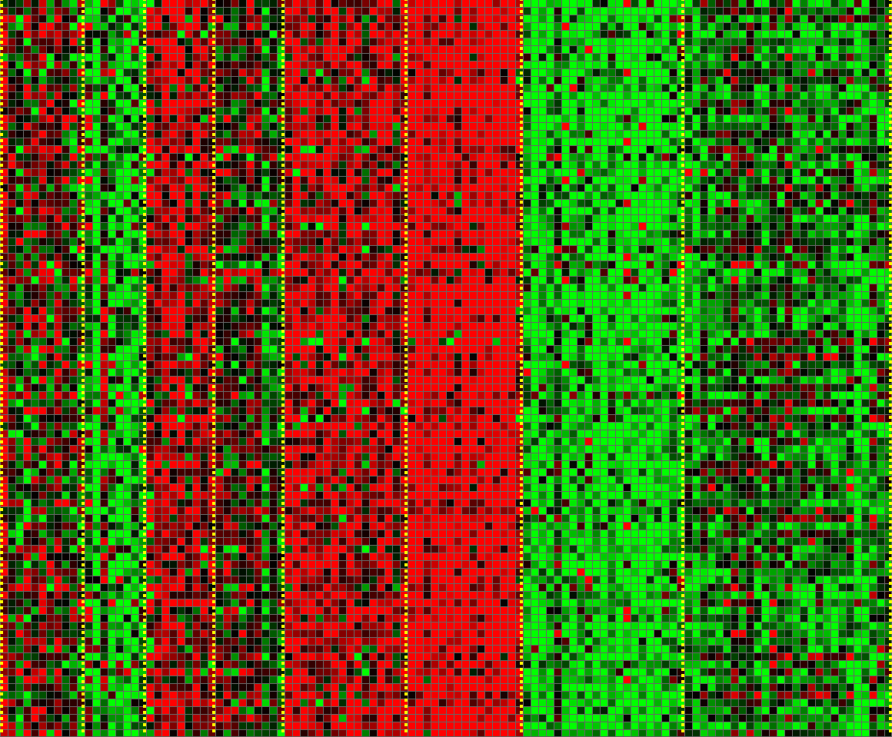
Unsupervised Learning
Genomics application: group individuals by genetic similarity
Genes
Individuals
[Source: Daphne Koller]

Slide 29

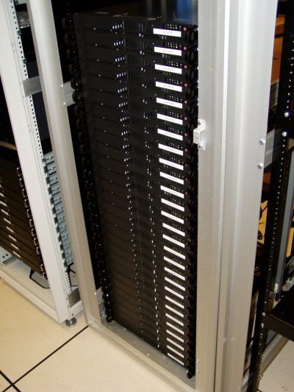
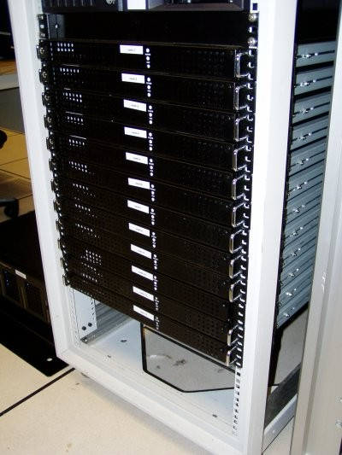




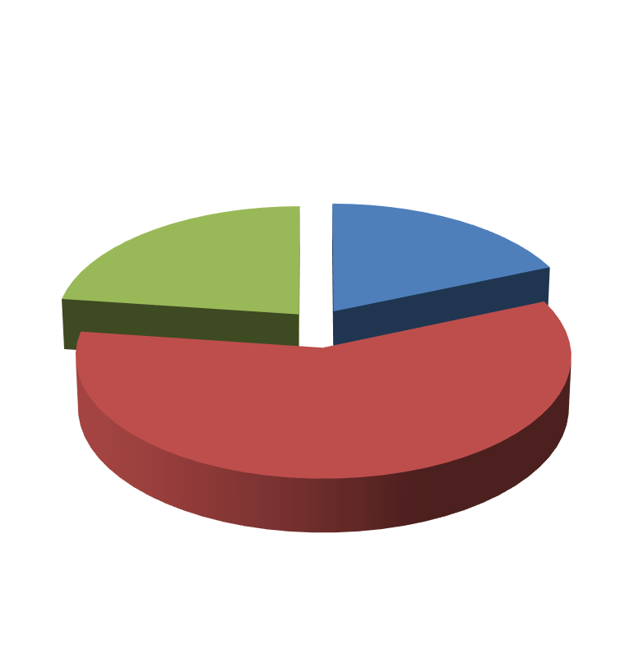

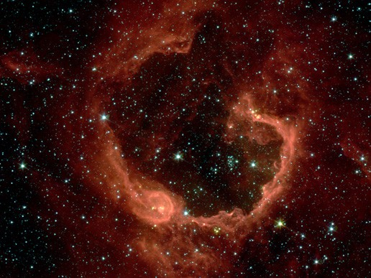


Unsupervised Learning
Organize computing clusters
Social network analysis
Market segmentation
Slide credit: Andrew Ng
Image credit: NASA/JPL-Caltech/E. Churchwell (Univ. of Wisconsin, Madison)
Astronomical data analysis

Slide 30
Reinforcement Learning
Given a sequence of states and actions with (delayed) rewards, output a policy
Policy is a mapping from states → actions that tells you what to do in a given state
Examples:
Credit assignment problem
Game playing
Robot in a maze
Balance a pole on your hand

Slide 31
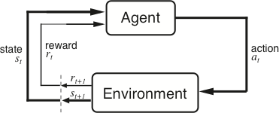
The Agent-Environment Interface
Agent and environment interact at discrete time steps Agent observes state at step t : s_{t} ∈S
: t = 0, 1, 2, K
produces action at step t : a_{t} ∈ A(s_{t} )
gets resulting reward : and resulting next state :
r_{t +1} ∈ℜ
^{s}t +1
. . .
^{r}t +1 _{st +1}
^{r}t +2 _{st +2}
^{r}t +3
. . .
s
t
a_{t}
^{s}t +3
ªt +1
ªt +2
ªt +3
Slide credit: Sutton & Barto

Slide 32
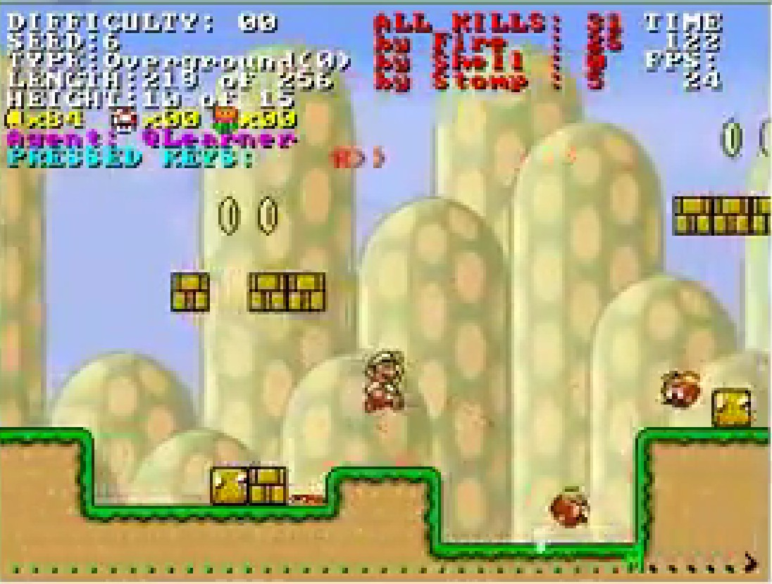
Reinforcement Learning
https://www.youtube.com/watch?v=4cgWya-wjgY

Slide 33

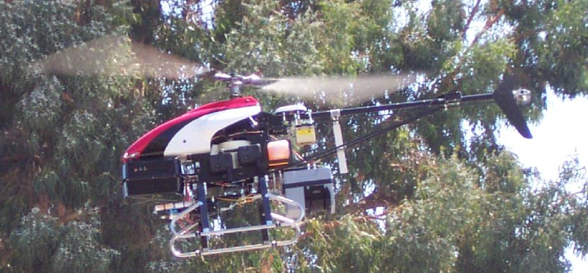
Inverse Reinforcement Learning
Learn policy from user demonstrations
Stanford Autonomous Helicopter http://heli.stanford.edu/ https://www.youtube.com/watch?v=VCdxqn0fcnE

Slide 34
Framing a Learning Problem

Slide 35






Designing a Learning System
Choose the training experience
Choose exactly what is to be learned
– i.e. the target function
Choose how to represent the target function
Choose a learning algorithm to infer the target function from the experience
Training data
Learner
Environment/ Experience
Knowledge
Testing data
Performance Element
Based on slide by Ray Mooney

Slide 36
Various Function Representations
Numerical functions
Linear regression
Neural networks
Support vector machines
Symbolic functions
Decision trees
Rules in propositional logic
Rules in first-order predicate logic
Instance-based functions
Nearest-neighbor
Case-based
Probabilistic Graphical Models
Naïve Bayes
Bayesian networks
Hidden-Markov Models (HMMs)
Probabilistic Context Free Grammars (PCFGs)
Markov networks
Slide credit: Ray Mooney

Slide 37
Various Search/Optimization Algorithms
Gradient descent
Perceptron
Backpropagation
Dynamic Programming
HMM Learning
PCFG Learning
Divide and Conquer
Decision tree induction
Rule learning
Evolutionary Computation
Genetic Algorithms (GAs)
Genetic Programming (GP)
Neuro-evolution
Slide credit: Ray Mooney

Slide 38
Evaluation
Accuracy
Precision and recall
Squared error
Likelihood
Posterior probability
Cost / Utility
Margin
Entropy
K-L divergence
etc.
47
Slide credit: Pedro Domingos

Slide 39


ML in Practice
Understand domain, prior knowledge, and goals
Data integration, selection, cleaning, pre-processing, etc.
Learn models
Interpret results
Consolidate and deploy discovered knowledge
Loop
Based on a slide by Pedro Domingos

Slide 40
A Brief History of Machine Learning

Slide 41
History of Machine Learning
1950s
Samuel’s checker player
Selfridge’s Pandemonium
1960s:
Neural networks: Perceptron
Pattern recognition
Learning in the limit theory
Minsky and Papert prove limitations of Perceptron
1970s:
Symbolic concept induction
Winston’s arch learner
Expert systems and the knowledge acquisition bottleneck
Quinlan’s ID3
Michalski’s AQ and soybean diagnosis
Scientific discovery with BACON
Mathematical discovery with AM
Slide credit: Ray Mooney

Slide 42
History of Machine Learning (cont.)
1980s:
Advanced decision tree and rule learning
Explanation-based Learning (EBL)
Learning and planning and problem solving
Utility problem
Analogy
Cognitive architectures
Resurgence of neural networks (connectionism, backpropagation)
Valiant’s PAC Learning Theory
Focus on experimental methodology
1990s
Data mining
Adaptive software agents and web applications
Text learning
Reinforcement learning (RL)
Inductive Logic Programming (ILP)
Ensembles: Bagging, Boosting, and Stacking
Bayes Net learning
Slide credit: Ray Mooney

Slide 43
History of Machine Learning (cont.)
2000s
Support vector machines & kernel methods
Graphical models
Statistical relational learning
Transfer learning
Sequence labeling
Collective classification and structured outputs
Computer Systems Applications (Compilers, Debugging, Graphics, Security)
E-mail management
Personalized assistants that learn
Learning in robotics and vision
2010s
Deep learning systems
Learning for big data
Bayesian methods
Multi-task & lifelong learning
Applications to vision, speech, social networks, learning to read, etc.
???
Based on slide by Ray Mooney

